Slide 1

Unsupervised ML –
Movies and TV Shows Clustering
- Gaurav Borole

Slide 2
Project Overview
Analyze Netflix Movies and TV Shows dataset
Perform Exploratory Data Analysis (EDA)
Clean and preprocess the dataset
Apply Unsupervised Machine Learning
Cluster similar content
Derive business insights for Netflix

Slide 3
PROBLEM STATEMENT
Netflix has a large and diverse content library
Understanding content patterns manually is difficult
There is no predefined grouping of content
We need to:
  Understand content trends
  Identify similarities
  Group similar shows and movies

Slide 4
BUSINESS CONTEXT
Netflix has shifted from movies to TV shows
Focus on regional and international content
Business teams need insights for:
  Content acquisition
  Marketing
  Regional strategy
  Recommendation systems

Slide 5
DATASET OVERVIEW
Dataset Information
  Source: Flixable (Netflix dataset)
  Time Period: Up to 2019
  Rows: Movies & TV Shows
  Each row = One Netflix title
Key Columns
  Type (Movie / TV Show)
  Country
  Release Year
  Rating
  Duration
  Genre
  Description

Slide 6
WHY UNSUPERVISED LEARNING?
Why Clustering?
  No labeled output available
  We don’t know groups beforehand
  Goal is to discover hidden patterns
Why Unsupervised ML?
  Automatically groups similar content
  Finds structure in data
  Useful for exploratory analysis

Slide 7
DATA CLEANING STEPS
Data Cleaning Performed :
  Handled missing values
  Standardized date formats
  Extracted duration values
  Removed irrelevant columns
  Checked duplicate records

Slide 8
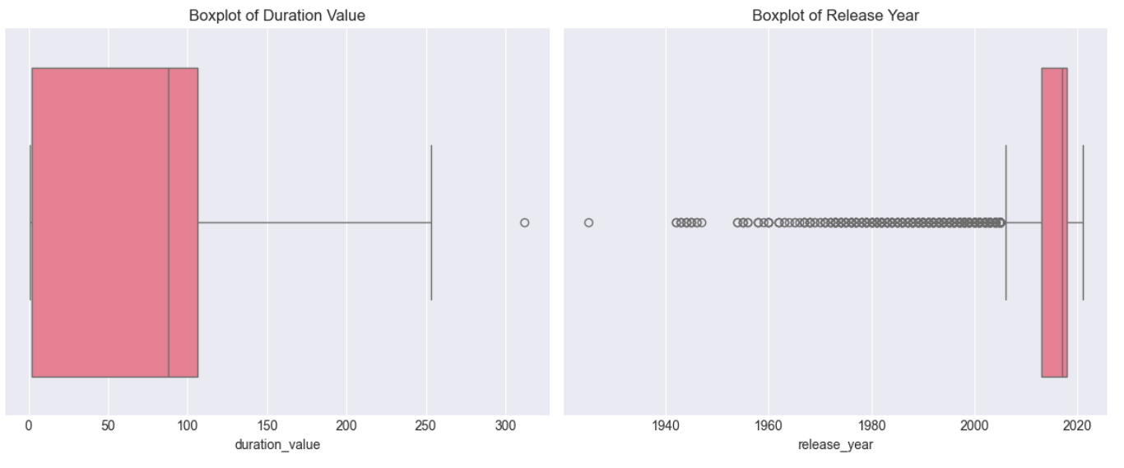
OUTLIERS & DATA QUALITY
Outlier & Data Quality Analysis
  Identified extreme values using boxplots
  Found long-duration TV shows
  Observed older content as natural outliers
  Outliers were not removed

Slide 9
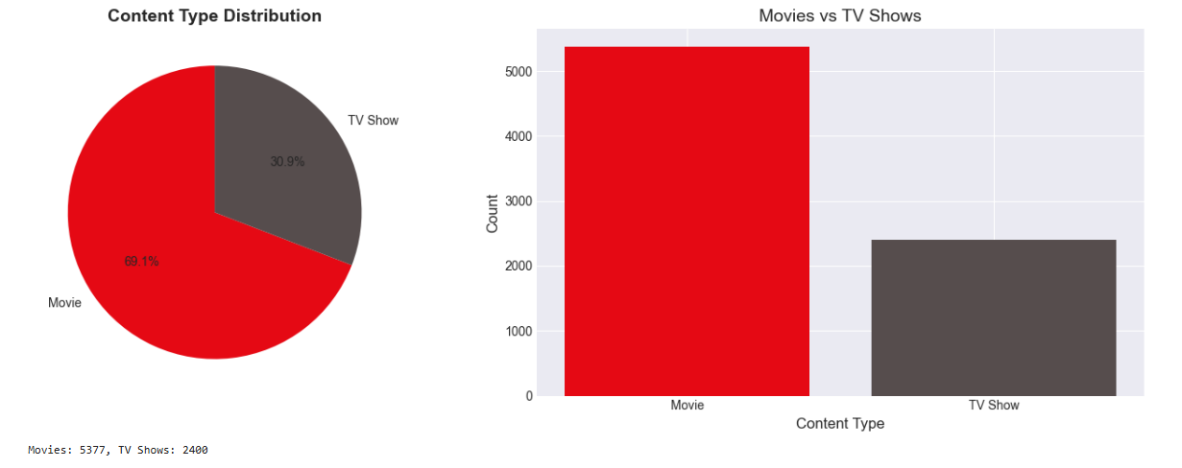
EDA – CONTENT TYPE DISTRIBUTION
EDA: Content Type Distribution
  Movies dominate overall content
  TV shows form a significant portion
  Indicates Netflix’s growing focus on TV content

Slide 10
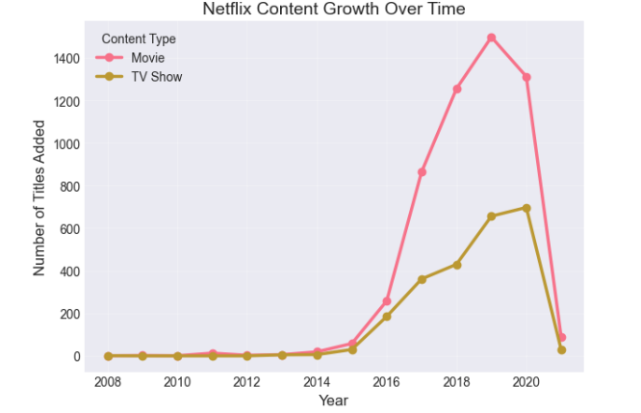
EDA – CONTENT GROWTH OVER TIME
EDA: Content Growth Over Time
  Rapid growth after 2015
  Reflects Netflix’s expansion phase
  Increased investment in original content

Slide 11
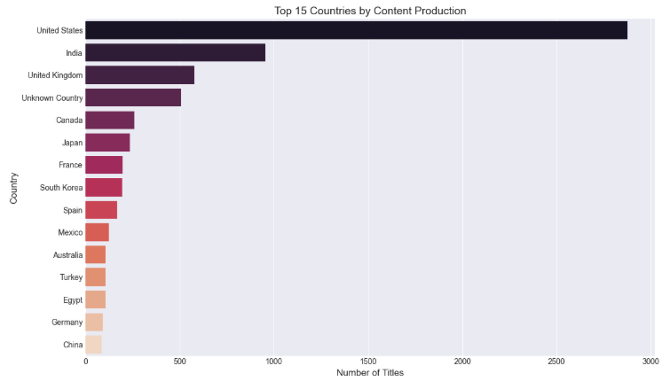
EDA – COUNTRY-WISE DISTRIBUTION
EDA: Country-wise Content
  USA and India dominate content production
  Other countries contribute niche content
  Shows regional focus

Slide 12
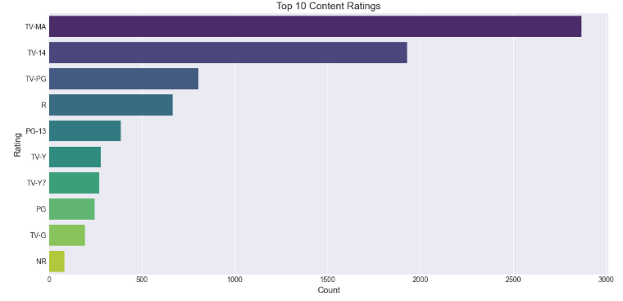
EDA – RATING DISTRIBUTION
EDA: Content Rating Distribution
  TV-MA and TV-14 dominate
  Focus on mature and young adult audiences

Slide 13
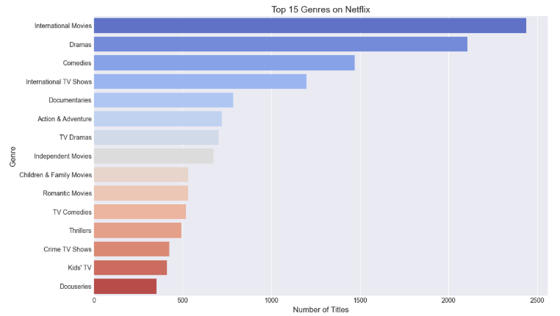
EDA – GENRE ANALYSIS
EDA: Genre Analysis
  Drama is the most common genre
  Strong presence of international content
  Supports global storytelling

Slide 14
FEATURE ENGINEERING
Numerical features:
  Release year
  Duration
Categorical features:
  Type
Text features:
  Genre
  Description

Slide 15
TEXT PROCESSING (TF-IDF)
Text Processing
  Used TF-IDF Vectorization
  Converts text into numerical form
  Highlights important words
  Reduces impact of common words

Slide 16
FEATURE SCALING
Feature Scaling
  Applied Standard Scaling
  Ensures equal contribution of features
  Essential for distance-based algorithms

Slide 17
CLUSTERING ALGORITHMS USED
Algorithms Used
  K-Means Clustering
  Hierarchical Clustering

Slide 18
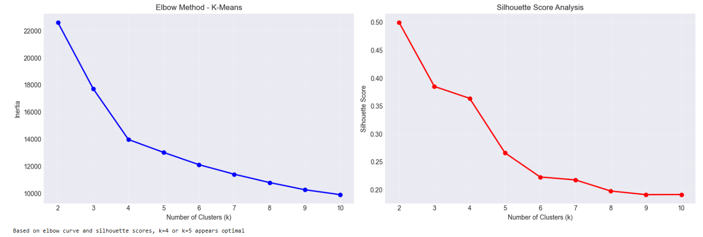
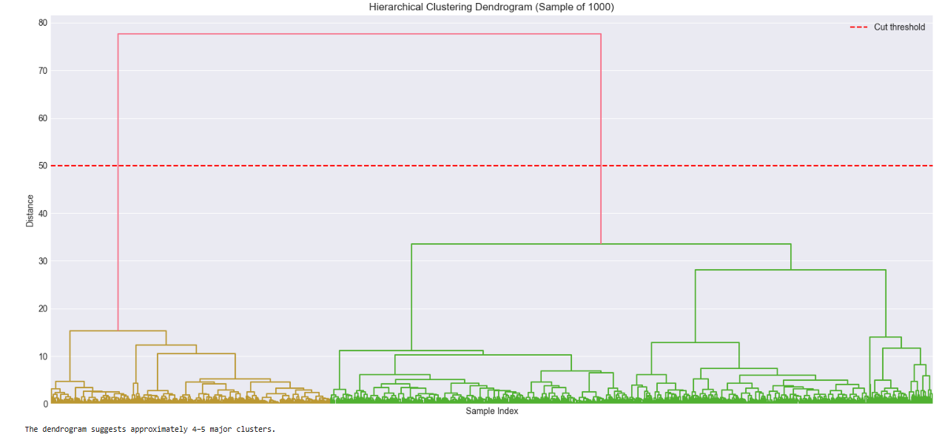
FINDING OPTIMAL CLUSTERS
Optimal Number of Clusters
  Elbow Method (K-Means)
  Dendrogram (Hierarchical)

Slide 19
CLUSTER INTERPRETATION
Cluster Interpretation
Each cluster represents a content segment
Grouped by similarity in:
  Genre
  Duration
  Description
  Type

Slide 20
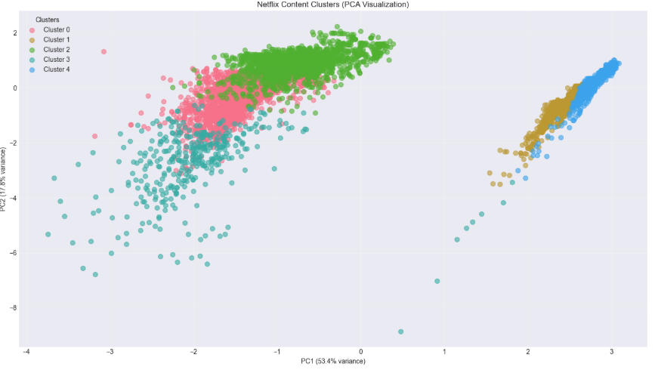
CLUSTER STRATEGY
Business Strategy per Cluster
  Regional promotion
  Targeted marketing
  Content acquisition decisions
  Personalized recommendations

Slide 21
STAKEHOLDER BENEFITS
Stakeholder Impact
  Content Team
  Marketing Team
  Recommendation Systems
  Regional Strategy Teams

Slide 22
CONCLUSION
Successfully clustered Netflix content
Identified key content patterns
Provided actionable business insights
Demonstrated end-to-end data science workflow

Slide 23
What I knew and What I learned…..

Slide 24
Thank You.

